Slide 1
Implications of Climate Change:
Ohio and the Mid-West
May 20, 2010
Charles Lucius, VP Sustainable Energy
for Don McConnell
President, Battelle Energy Technology

Slide 2
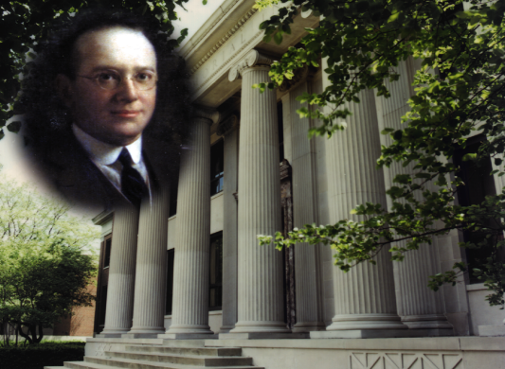
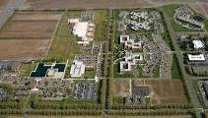
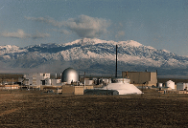
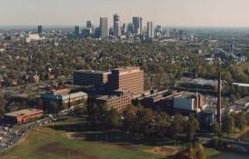
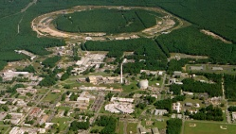
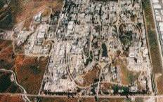
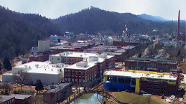


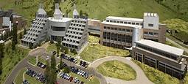
Battelle: A global leader in Research and
Development for over 8 decades
Founded in 1929 in Columbus, Ohio:
To do “creative and research work”;
The “making of discoveries and inventions”
Their “reduction to practice and disposal on such terms as seems most advantageous”
Today:
  $5.2 billion revenues
  21,000 staff
  9 major laboratories
  $920 million energy RD&D
Our core purpose is translating scientific discovery to innovative commercial applications

Slide 3
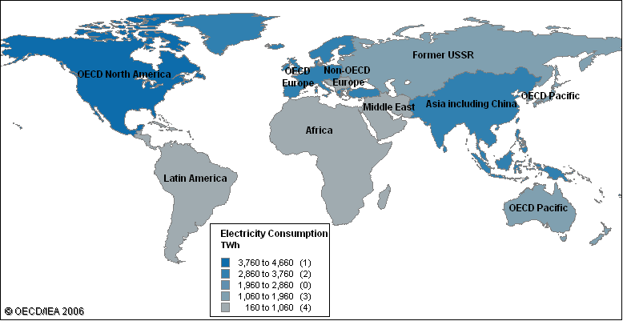
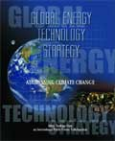

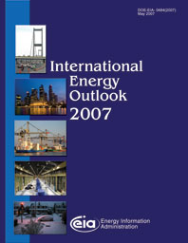
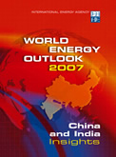

Alternative global energy scenarios provide insights into the challenges shaping our potential energy futures

Slide 4
Climate impact models suggest changes in Ohio and North America weather patterns
Precipitation will increase in the Mid-West and decline in the Southwest states
Rainfall will increase and snow fall decrease, especially in the Northwest, shifting water availability
Growing seasons lengthen, shifting warmer region plants species northward
Growth rates accelerate as CO₂ concentration increases
Hurricanes will become less frequent, but substantially more intense
Storm activity increases in intensity

Slide 5
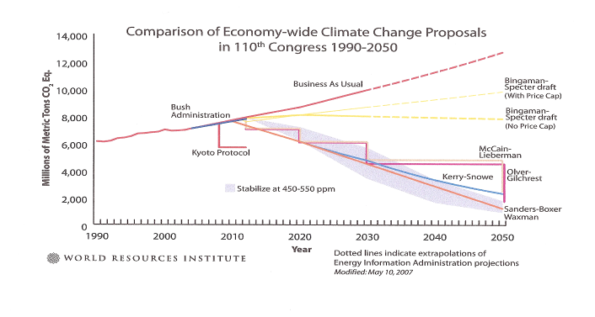
Responding to climate change will drive
dramatic changes in industrial and energy systems
110TH CONGRESS
1ST SESSION
S. 139
To direct the Administrator of the Environmental Protection Agency to establish
a program to decrease emissions of greenhouse gases, and for other purposes.
_____________________________________________
IN THE SENATE OF THE UNITED STATES
OCTOBER 18, 2007
Mr. LIEBERMAN (for himself, Mr. WARNER, Mr. HARKIN, Mr. COLEMAN, Mrs.
DOLE, Ms. COLLINS, Mr. CARDIN, Ms. KLOBUCHAR, and Mr. CASEY) introduced
  the following bill; which was read twice and referred to the Committee
on Environment and Public Works
___________________________________________
A BILL.
To direct the Administrator of the Environmental Protection Agency to establish a program to decrease emissions of greenhouse gases, and for other purposes
McCain-Lieberman
110TH CONGRESS
1ST SESSION
S. 2191
To direct the Administrator of the Environmental Protection Agency to establish
a program to decrease emissions of greenhouse gases, and for other purposes.
_____________________________________________
IN THE SENATE OF THE UNITED STATES
OCTOBER 18, 2007
Mr. LIEBERMAN (for himself, Mr. WARNER, Mr. HARKIN, Mr. COLEMAN, Mrs.
DOLE, Ms. COLLINS, Mr. CARDIN, Ms. KLOBUCHAR, and Mr. CASEY) introduced
  the following bill; which was read twice and referred to the Committee
on Environment and Public Works
___________________________________________
A BILL.
To direct the Administrator of the Environmental Protection Agency to establish a program to decrease emissions of greenhouse gases, and for other purposes
Lieberman-Warner
110TH CONGRESS
1ST SESSION
S. 3036
To direct the Administrator of the Environmental Protection Agency to establish
a program to decrease emissions of greenhouse gases, and for other purposes.
_____________________________________________
IN THE SENATE OF THE UNITED STATES
OCTOBER 18, 2007
Mr. LIEBERMAN (for himself, Mr. WARNER, Mr. HARKIN, Mr. COLEMAN, Mrs.
DOLE, Ms. COLLINS, Mr. CARDIN, Ms. KLOBUCHAR, and Mr. CASEY) introduced
  the following bill; which was read twice and referred to the Committee
on Environment and Public Works
___________________________________________
A BILL.
To direct the Administrator of the Environmental Protection Agency to establish a program to decrease emissions of greenhouse gases, and for other purposes
Boxer
110TH CONGRESS
1ST SESSION
HR 6186. _____
To direct the Administrator of the Environmental Protection Agency to establish
a program to decrease emissions of greenhouse gases, and for other purposes.
_____________________________________________
IN THE SENATE OF THE UNITED STATES
OCTOBER 18, 2007
Mr. LIEBERMAN (for himself, Mr. WARNER, Mr. HARKIN, Mr. COLEMAN, Mrs.
DOLE, Ms. COLLINS, Mr. CARDIN, Ms. KLOBUCHAR, and Mr. CASEY) introduced
  the following bill; which was read twice and referred to the Committee
on Environment and Public Works
___________________________________________
A BILL.
To direct the Administrator of the Environmental Protection Agency to establish a program to decrease emissions of greenhouse gases, and for other purposes
Markey
110TH CONGRESS
1ST SESSION
S._____
To direct the Administrator of the Environmental Protection Agency to establish
a program to decrease emissions of greenhouse gases, and for other purposes.
_____________________________________________
IN THE SENATE OF THE UNITED STATES
OCTOBER 18, 2007
Mr. LIEBERMAN (for himself, Mr. WARNER, Mr. HARKIN, Mr. COLEMAN, Mrs.
DOLE, Ms. COLLINS, Mr. CARDIN, Ms. KLOBUCHAR, and Mr. CASEY) introduced
  the following bill; which was read twice and referred to the Committee
on Environment and Public Works
___________________________________________
A BILL.
To direct the Administrator of the Environmental Protection Agency to establish a program to decrease emissions of greenhouse gases, and for other purposes
Voinovich
Waxman-Markey
110TH CONGRESS
1ST SESSION
HR._____
To direct the Administrator of the Environmental Protection Agency to establish
a program to decrease emissions of greenhouse gases, and for other purposes.
_____________________________________________
IN THE SENATE OF THE UNITED STATES
OCTOBER 18, 2007
Mr. LIEBERMAN (for himself, Mr. WARNER, Mr. HARKIN, Mr. COLEMAN, Mrs.
DOLE, Ms. COLLINS, Mr. CARDIN, Ms. KLOBUCHAR, and Mr. CASEY) introduced
  the following bill; which was read twice and referred to the Committee
on Environment and Public Works
___________________________________________
A BILL.
To direct the Administrator of the Environmental Protection Agency to establish a program to decrease emissions of greenhouse gases, and for other purposes
First Auctions - 2011
110TH CONGRESS
1ST SESSION
HR.__2454___
To direct the Administrator of the Environmental Protection Agency to establish
a program to decrease emissions of greenhouse gases, and for other purposes.
_____________________________________________
IN THE HOUSE OF THE UNITED STATES
OCTOBER 18, 2007
Mr. LIEBERMAN (for himself, Mr. WARNER, Mr. HARKIN, Mr. COLEMAN, Mrs.
DOLE, Ms. COLLINS, Mr. CARDIN, Ms. KLOBUCHAR, and Mr. CASEY) introduced
  the following bill; which was read twice and referred to the Committee
on Environment and Public Works
___________________________________________
A BILL.
To direct the Administrator of the Environmental Protection Agency to establish a program to decrease emissions of greenhouse gases, and for other purposes
2005
Markey iCAP
Boucher
Waxman-Markey
Key Factors / Variables in Stabilizing Atmospheric CO₂ Concentrations
Rate of reductions
Early action incentives
Scope of coverage
Base year
Carbon credit allocation / auction
Impact reduction credits
Technology investment
International linkage

Slide 6
Changes in US carbon legislation are impacting energy technology market dynamics & timing
US Senate: Kerry-Graham-Lieberman draft outline
Economy wide “cap & trade is dead” in House and Senate
Shifting to “staged progressive implementation” with “tightly regulated” carbon trading, with timelines varying across industries
  Large point source emitters (i.e. utilities) to be “first to be regulated”
Uncertain time to regulation of major industrial emitters:“3 to 10 years from implementation”
Proposing carbon tax on fuels for transportation
House staff open to replacement for Waxman-Markey bill
Legislation concepts favorably received by industry associations
EPA Regulation Outlook
Discussions with Senate ongoing
Focus on Title 5 major emitters: >75,000 tons/year
Phased implementation possible

Slide 7
Carbon limits will ultimately require economical
“net zero” emission fossil energy technologies
“Air and Water Neutral” conversion: essential to utilization of domestic reserves while reducing carbon footprint
Economic carbon capture and permanent CO₂ disposition critical to transition
Renewables penetration at utility scale
“Electrification” of transportation
Expanded use of economical biofuels
Market acceptance will require a long-term policy on CO₂ emissions reduction
Early adopter incentives important to timely action
Technology can be of great benefit as an export to developing Asian economies
DOE Vision 21

Slide 8
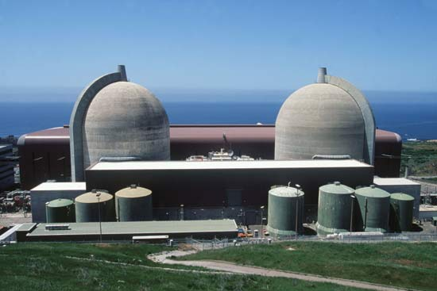
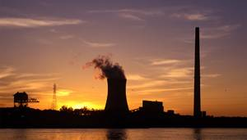
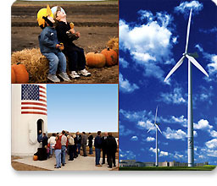
Current zero emission options require massive capital investments
Capital investment required for carbon free power generation capacity
Nuclear: $14 billion per plant (1 GWe); ~$7k / Kw
IGCC with 90% CCS: $3 billion for 600 Mw; ~$5k / Kw
Retrofit of existing fossil plants: ~$1.2 billion for 580 Mw; ~+$2k / Kw
Wind farm of 150Mw capacity: ~ $1 billion; ~$6k / Kw

Slide 9
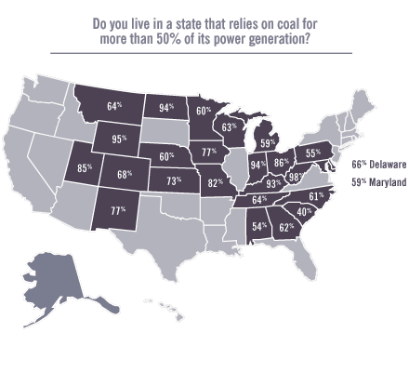
Dependence on fossil fueled electricity generation represents a major Mid West transition challenge
Source: DOE Energy Information Agency

Slide 10
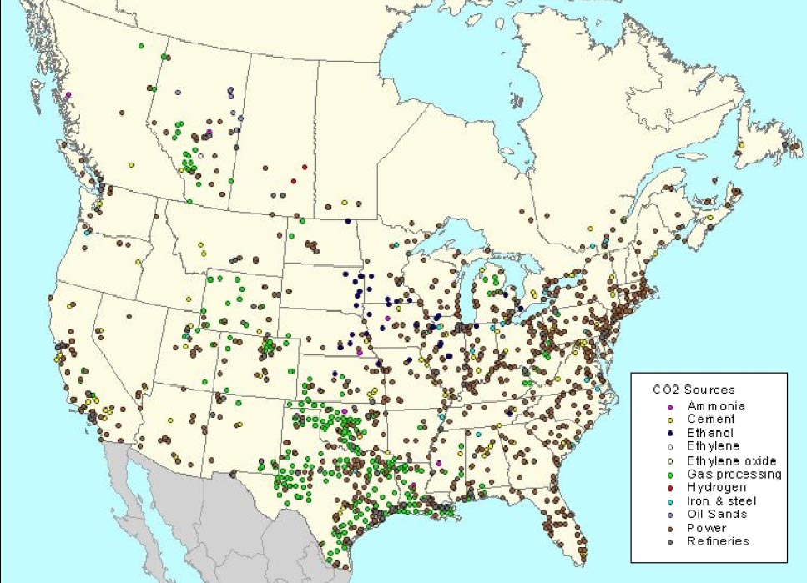
The Mid-West manufacturing cluster faces significant competitive pressures under carbon limits
Power generation
Materials processing
Manufacturing
Gas processing
Ethanol / chemicals
Dominated by
power generation
Oil & gas processing
Refining
Petrochemicals
Major US CO² emitting industries
Source: EPA

Slide 11
Two challenges face the Ohio economy during the transition to a clean energy future
Strategic industries must transform themselves to no-carbon or low-carbon emission operations
    To moderate this impact we must develop and provide near-term cost-effective solutions for US industry
US manufacturers & their supply chain must strategically reposition for global clean economy markets
    Manufacturers in supply chains serving declining industries have an opportunity to enter the emerging clean energy economy worldwide
Without providing industry the tools to do so risks the economic competitiveness of key industries and resulting loss of jobs

Slide 12
Clean Economy of the Future:
More highly integrated and efficient manufacturing enterprise
Increased energy efficiency and reduced waste streams requires integration across industry sectors
Shift to “near net shape” specialty materials tailored for specific purposes and product forms from commodity materials
Growth of electricity as common media for energy transfer, including transportation
Biofuels are critical to transportation but cannot replace fossil directly
Decarbonization of electric power will require a full spectrum of generation including competitive clean fossil and nuclear power and renewables
Carbon capture and sequestration / disposition is a critical enabling technology across all industrial sectors in reducing carbon emissions
Transformation of regulatory environment is essential to integration and effectiveness of energy generation and use across state and regional boundaries
Better informed and competent populace, well versed in their role in new energy systems is critical to realizing national goals
Notes:
Recent engagements with affected industries suggests that the internal capacity to adapt to competitive pressures may be inadequate to the scope, scale and pace of the task
Recent ARRA FOA packages on industrial carbon source reduction led to a significant number of inquiries from effected industries, most notably steel and ceramics producers
The scope and magnitude of the challenge was clearest in the case of Midwest Steel producers where each blast furnace when operating has a carbon signature comparable to a coal fired generating plant
Attacking CO2 emissions from steel production required a four year, $200 million effort to integrate co-generation / capture of CO2 with blast furnace operation
Of four efforts, none went to proposal because:
EIS filing was a two year process
No capture or co-gen process was available to meet the demands of the application
No sequestration site was readily identifiable
More importantly,
None of the companies had internal capability to do process modification and optimization at the scale or at the speed required to meet the FOA requirements.
The level of technical risk was so great such that a business case could not drawn to support shareholder investment as the sole source of financing
Project level financing was not available in the private capital markets

